Slide 1

AGENCY
“HOW TO DO GUIDE”

Slide 2


WORKER OVERVIEW

Slide 3
MANAGE WORKER

Slide 4
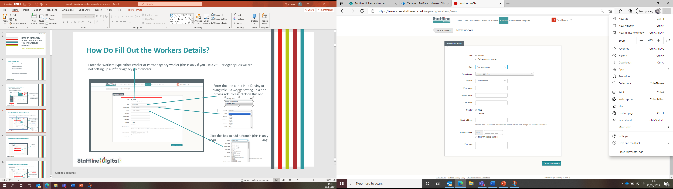
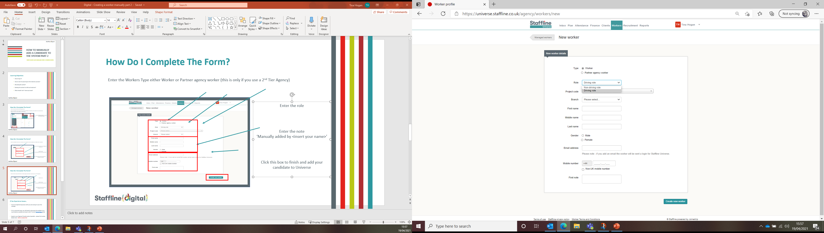
How To Fill Out The Workers Details?
Enter the worker's type. You need to select worker here.
Select the role from the dropdown.

Slide 5
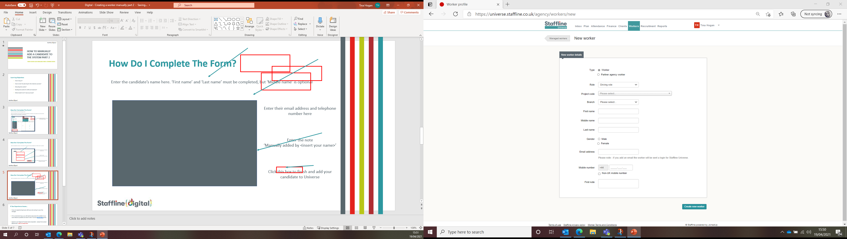
How To Fill Out The Workers Details?
Enter the candidate’s name here. ‘First name’ and ‘Last name’ must be completed, but ‘Middle name’ is optional.
Enter gender here.

Slide 6

How To Fill Out The Workers Details?
Enter their mobile number.
If Non-UK mobile number, please tick the box.
If you required to add any notes add in the First Note section
Finally press on the right hand
corner to create new worker.

Slide 7
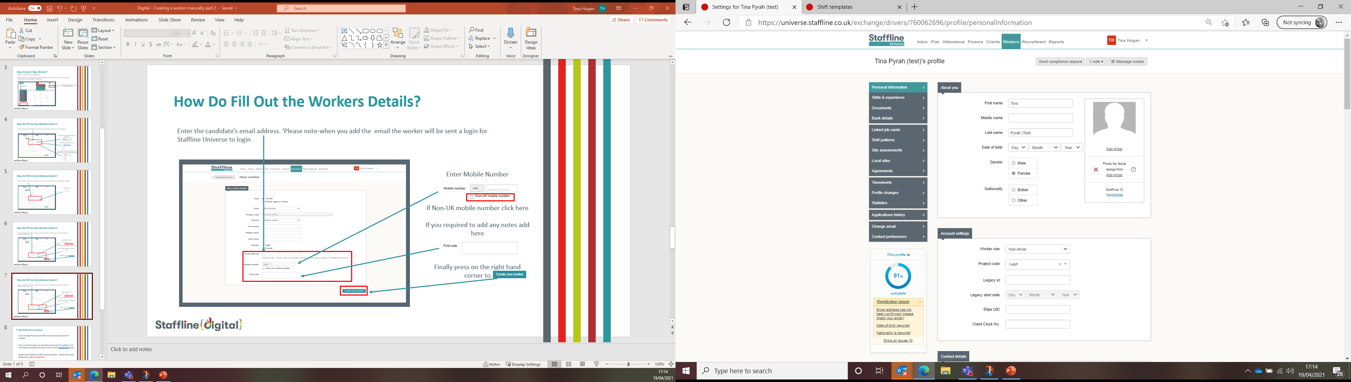
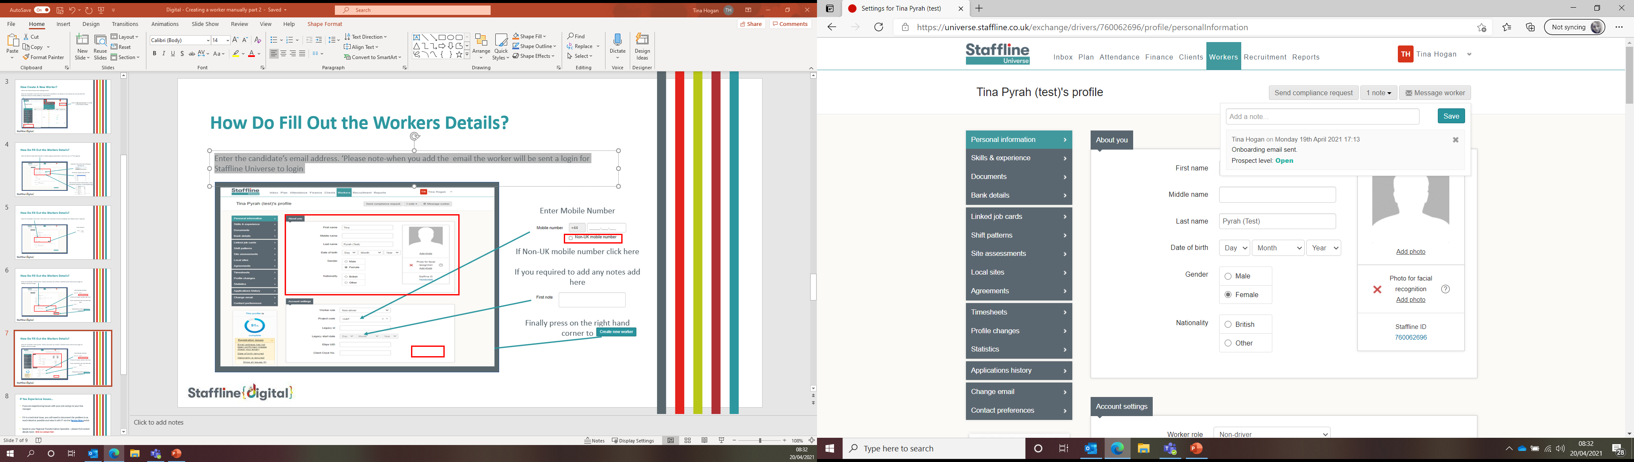
How Do I Fill Out The Workers Details?
Next, we need to complete the about you section, add date of birth and nationality.
Under notes on the top right, you will notice a message stating
'Onboarding email sent'.

Slide 8
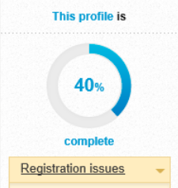
How To Reduce Incomplete Profile?
Once a section is completed, the profile percentage will start to decrease until it reaches 100%. Underneath the profile percentage, it will also show issues that are outstanding with the profile.
The following sections will need to be completed so that the registration percentage reaches 100%, this way the worker can then be made compliant.

Slide 9
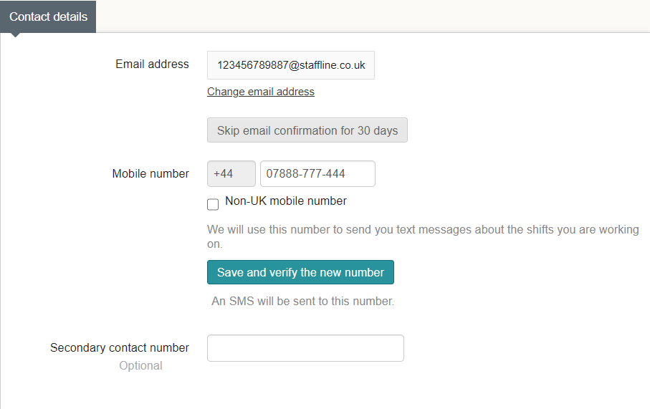
How To Complete Contact Details?
Contact details need to be verified, this will be through email and text message. If the worker doesn’t confirm email address, you can skip for 30 days while you get the worker to confirm.

Slide 10
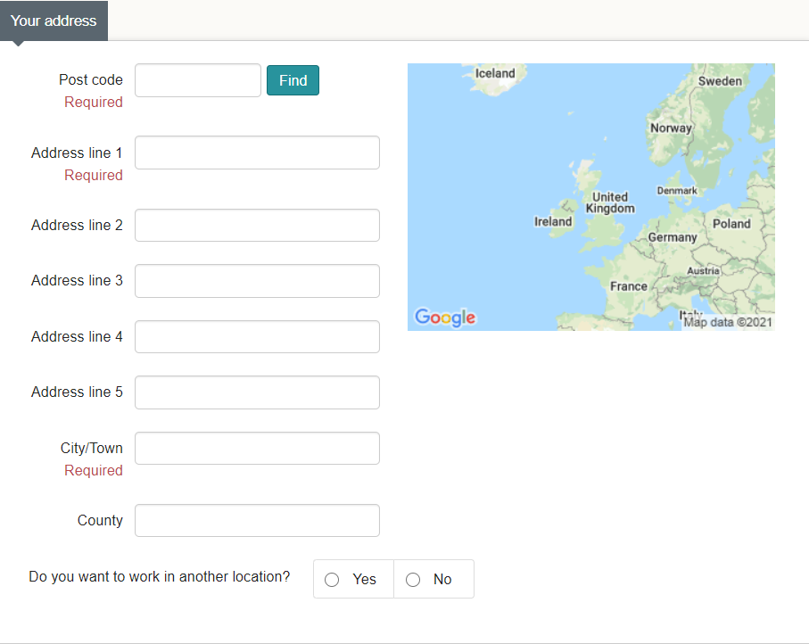
How To Complete Your Address?
To complete the address, you can manually add in all the information or add in the post code which will give you a drop down to find the number of the house/road.
Once the address has been found press enter and this will fill out all the slots.
The worker can also be added to – Do you want to work in another location,
click 'Yes' or 'No'.

Slide 11

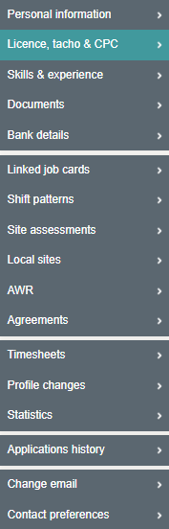
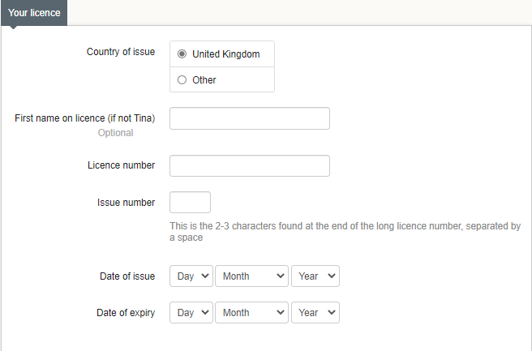
How To Complete Licence?
Go to Licence, Tacho and CPC on the left-hand side of the worker's profile.
Please fill in the following information:
Add in the country of issue. Follow the UK guidelines for licenses. If other use the dropdown to select the country.
Entre the full name on the Licence.
Enter the Licence number on the driving Licence card
Enter the issue number.
Date of Issue.
Date of Expiry.

Slide 12
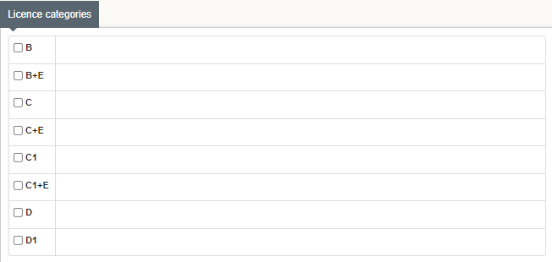
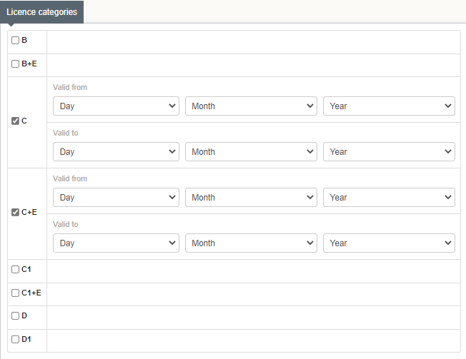
How To Complete Licence Categories?
To add a category, click on to the category that appears on the licence.
Then enter the valid date from and to.
Click on save changes.

Slide 13

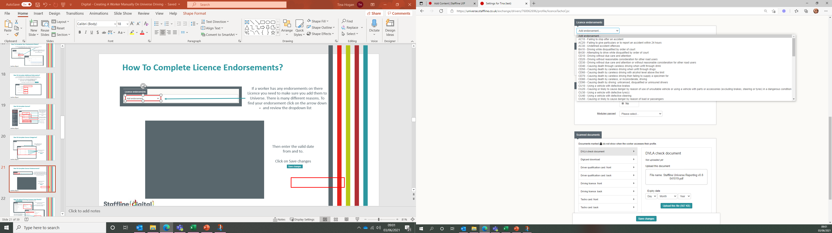
How To Complete Licence Endorsements?
If a worker has any endorsements on their licence, you need to make sure you add them to Universe. To find your endorsement click on the drop-down arrow to review the dropdown list.
Once you have entered the reason you will need to fill out the dates of offence.

Slide 14
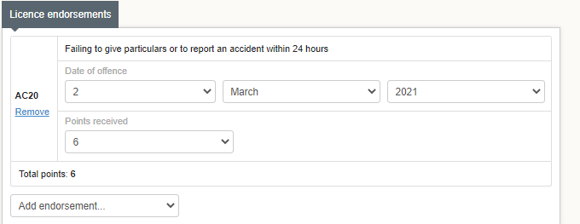
How To Complete Licence Endorsements?
Add the date of the offence
The points issued
If required add any additional endorsements.
Once completed press save change.

Slide 15
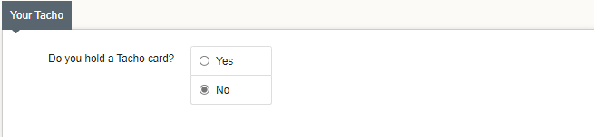
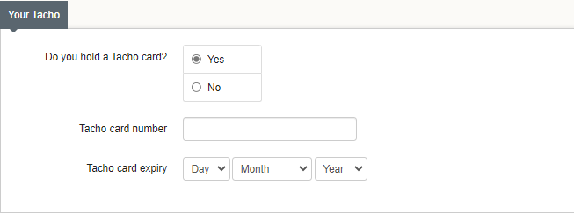
How To Complete Your Tacho?
Now we need to complete the Tacho part, if required click 'Yes'.
Next, we need to add in the Tacho number and expiry date.
Once completed press save changes.

Slide 16
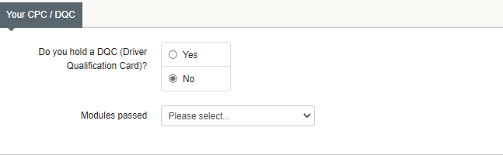
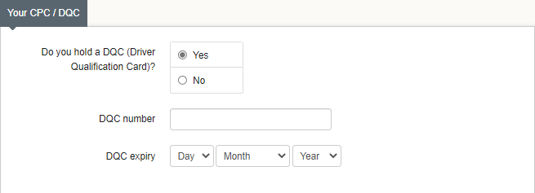
How To Complete Your CPC/DQC?
Now we need to complete the CPC/DQC part if required click on 'Yes'.
Add in the DQC number and expiry date.
Once completed press save changes.

Slide 17
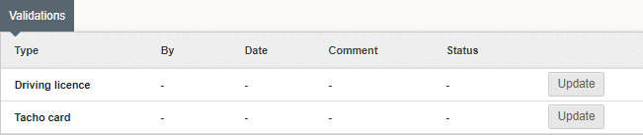
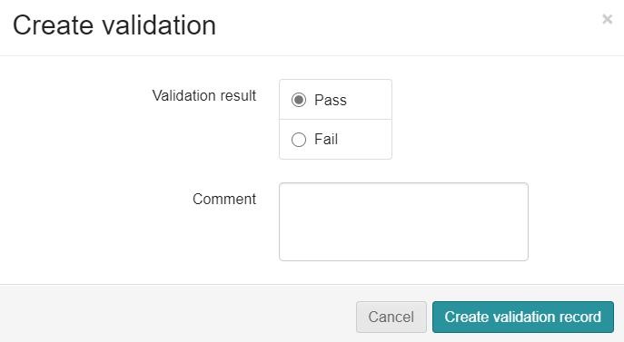
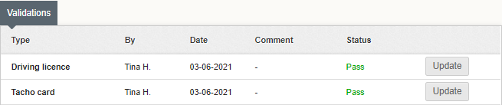
How To Complete Validations For Licence And Tacho?
To validate the workers Licence And Tacho, you will need to click onto each one and validate.
Click on update.
Pass the worker.
If you click fail the worker will not be able to be placed out into work. This would be a decline in the interview process.
Add any comments.
Click on
'Create
Validation record'.
Repeat the process on the
Tacho Card.
You will now see both sections have been updated and status is Pass.

Slide 18
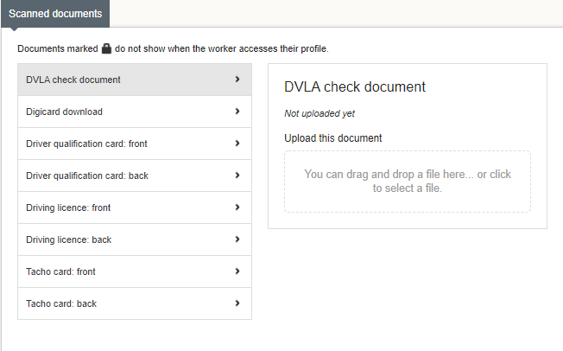
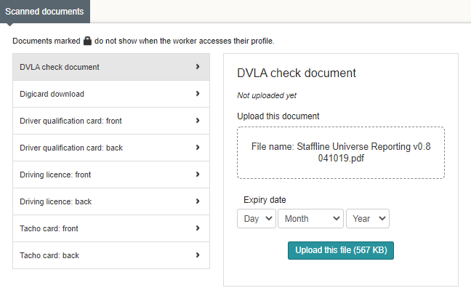
How To Upload Driving Licenses And Checks?
The next section to complete is the scanned document section.
Click on the section you would like to upload DVLA checks.
You can either drag and drop the file or upload from your desktop.
Click on the section and take the expiry date from the passport/ID card.
Once you have pressed upload this file, you will see a padlock next to the selected box. This means the worker cannot delete the file.

Slide 19
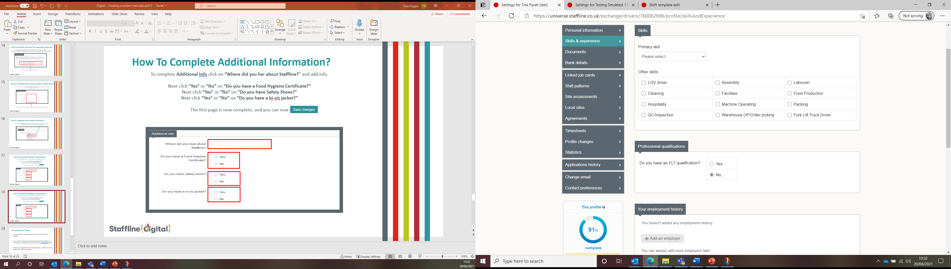
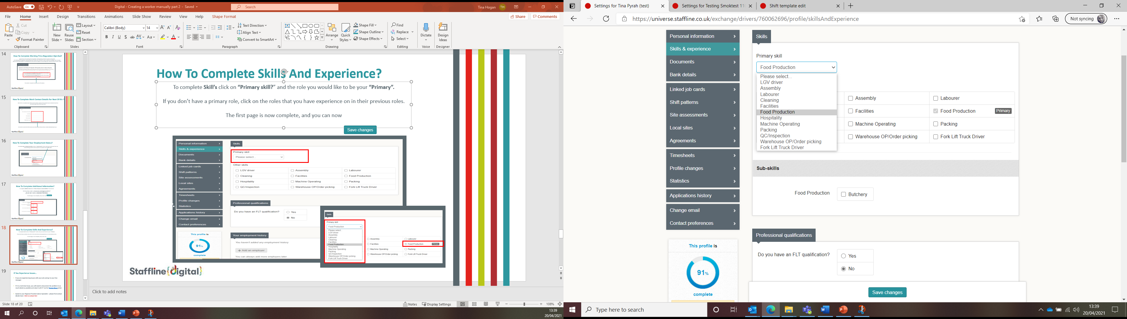
How To Complete Skills And Experience?
To complete Skill’s first select a primary skill.
If you don’t have a primary skill, click on the roles that they have experience on in their previous work history. You can also select other skills and sub-skills.
Once added press save changes.

Slide 20
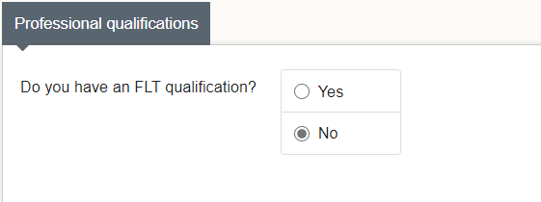
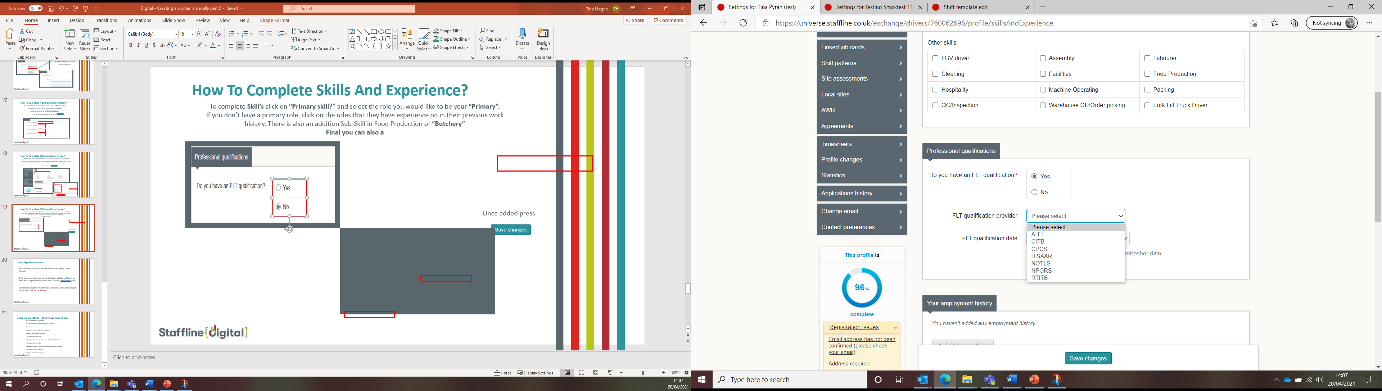
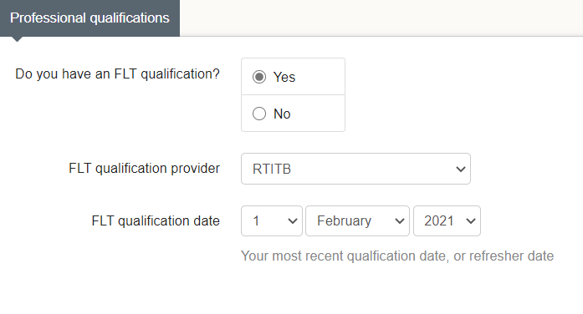
How To Complete Skills And Experience?
To complete professional qualifications, select whether you have an FLT license or not.
If yes is selected, an additional box will appear with FLT qualification provider and FLT qualification date.
Insert the license from the drop down and input the most recent qualification date or refresher date.
Once added press save changes.

Slide 21
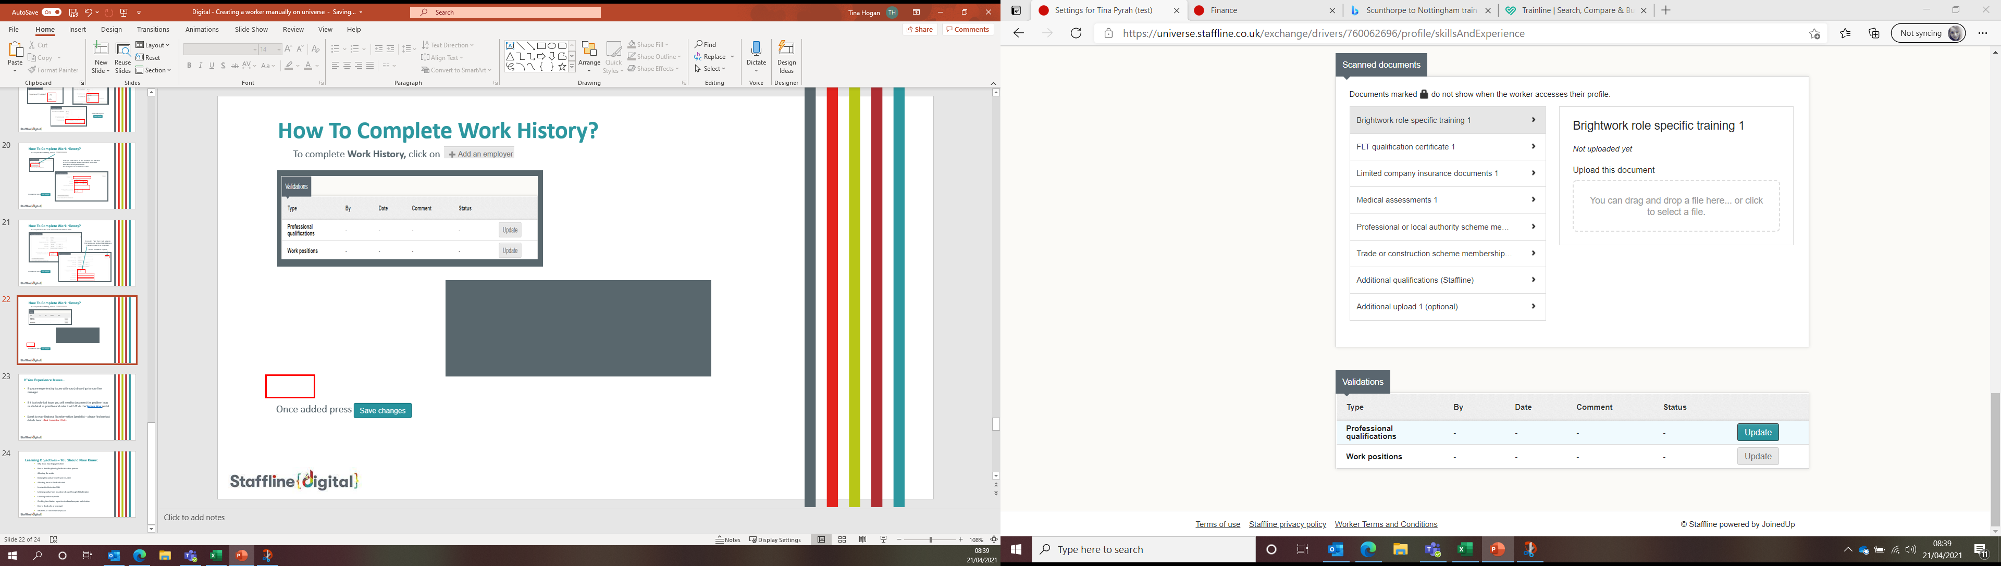
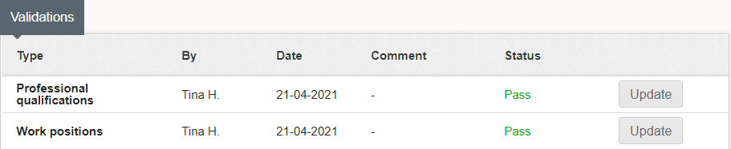
How To Complete Validations For Skills?
To validate the skills section of a worker's profile, you will need to click on each one to validate.
Add any comments
Click on
'Create
Validation record'.
Pass the worker.
If you click fail the worker will not be able to be placed out into work. This would be a decline in the interview process.
Repeat the process on the work positions.
You will now see both sections have been updated and the status is Pass.

Slide 22
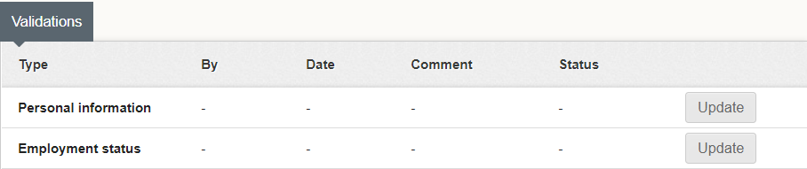
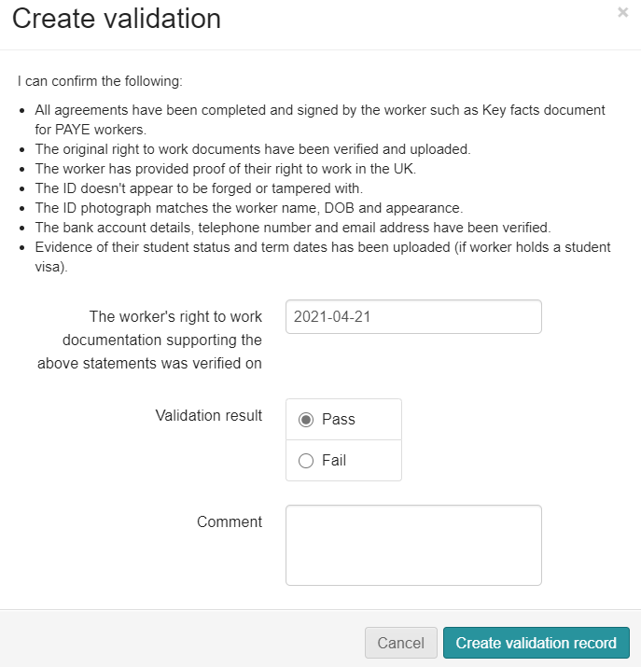
How To Validate The Workers Personal Information And Employment Status?
This is the same process as validating the skills section, but you will have to do your check list before you click pass.
Click on update for
personal information and
employment status.
When confirming the validation of the worker you are confirming the following.
One happy, you can pass the worker, add a comment and then select 'Create validation record'.

Slide 23
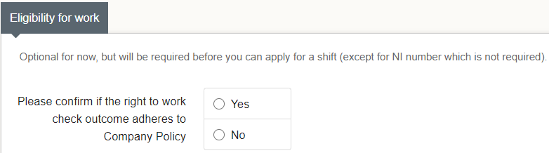
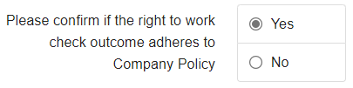
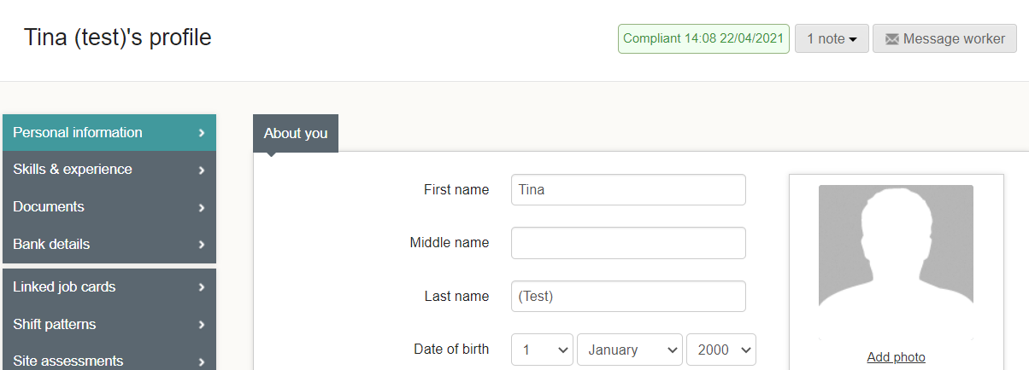

How To Make The Worker Compliant?
The last requirement to enable you to place the worker onto an Induction is to confirm if the right to work check outcome adheres to company policy.
Once you have click on 'Yes' you will see at the top of the page the worker will turn compliant.
If you click on 'No' you will see at the top of the page the worker will have failed compliant.

